Slide 1
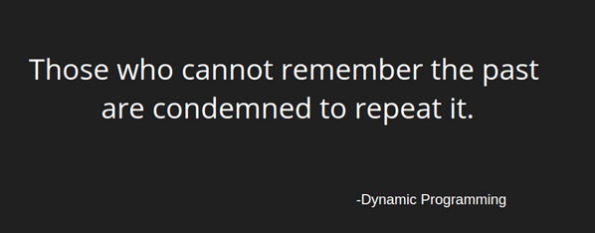
Introduction to Dynamic Programming

Slide 2

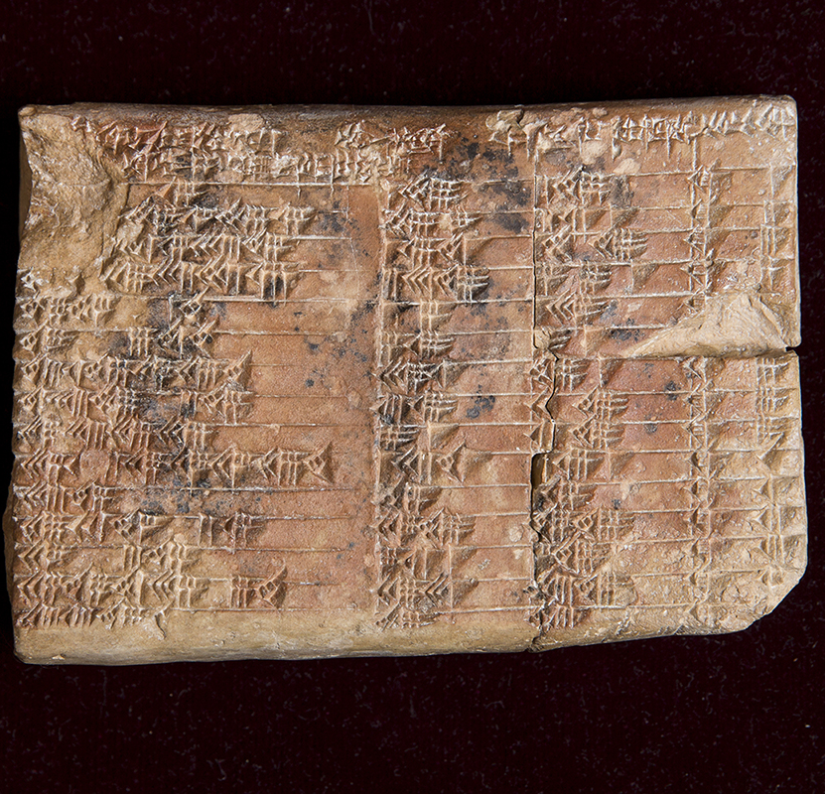
First, let’s talk about algorithms... What are they?
In mathematics and computer science, an algorithm is a finite sequence of well-defined, computer-implementable instructions, typically used solve a class of specific problems or to preform a computation
There are algorithms to solve many types of different problems: from the algorithm that controls the ranking of Google’s web pages to the algorithm that dictates how to make an (edible) peanut butter sandwich
A common misconception that I have seen regarding algorithms is that they were invented following the debut of computers, though this is hardly the truth!
Algorithms have existed for thousands of years, the earliest recorded algorithms being from Babylon dating back to 1600 B.C.
Babylonian clay tablet depicting class of algorithms

Slide 3

What is dynamic programming?
Dynamic Programming (commonly referred to as DP) is an algorithmic technique for solving a problem by recursively breaking it down into simpler subproblems and using the fact that the optimal solution to the overall problem depends upon the optimal solution to it's individual subproblems.
Dynamic Programming is both a mathematical optimization method and a computer programming method, developed by applied mathematician Richard Bellman in the 1950s
Dynamic Programming has found applications in numerous fields, some of which include mathematics, computer science, engineering, economics and business
Photo of Richard Bellman

Slide 4

What makes dynamic programming unique?
Dynamic programming is one of the many algorithm design paradigms that are utilized when devising algorithms to solve problems
You may have heard of some of other algorithm design paradigms in the past, some of the most common being brute force, backtracking, divide and conquer, etc.
Dynamic programming is quite similar to another paradigm, that being divide and conquer, wherein a problem is broken down into many simpler subproblems and then combined to answer the original problem
Dynamic programming takes this strategy one step further, however, which we will see in the coming slides

Slide 5
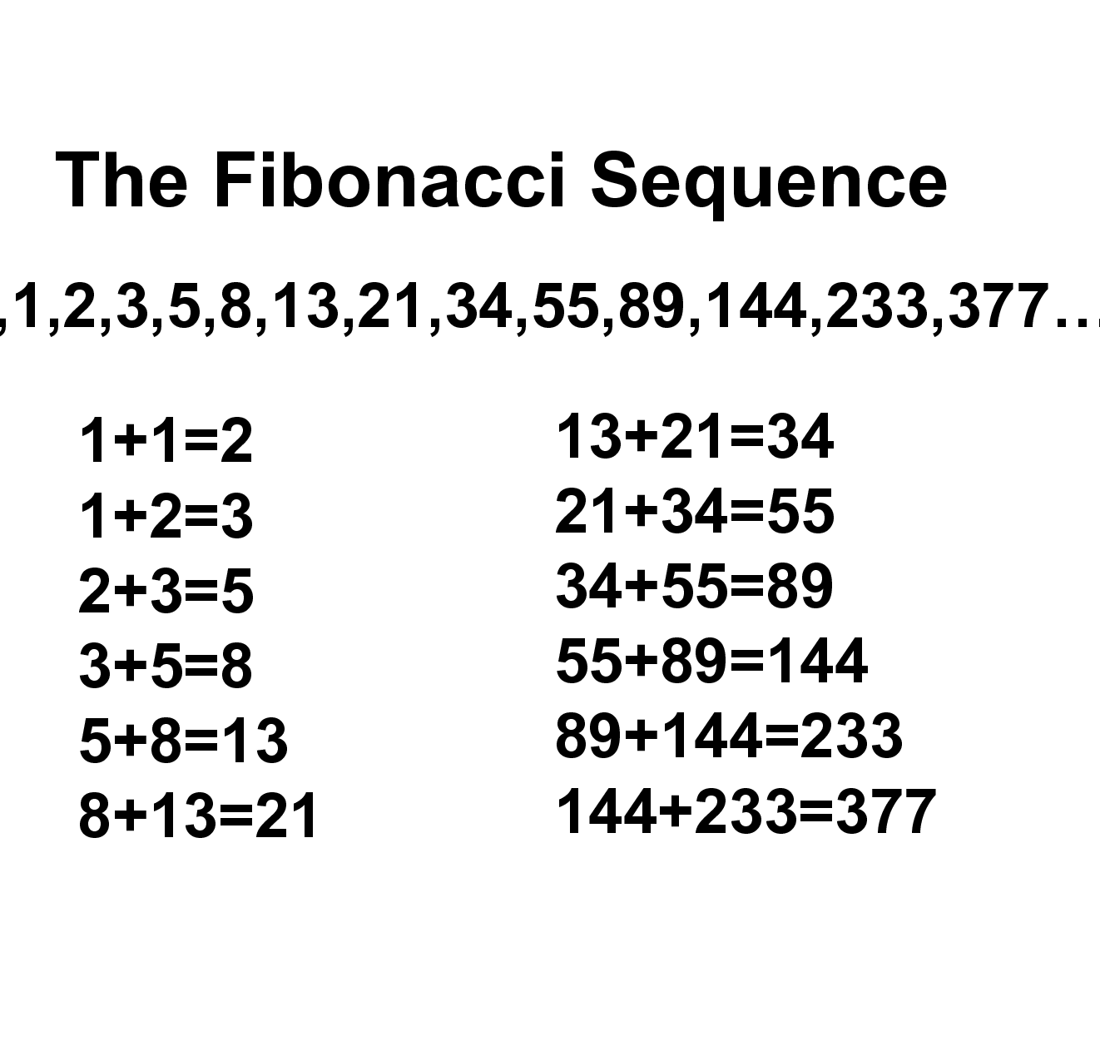
Let’s look at the Fibonacci sequence
In mathematics, the Fibonacci sequence is a sequence of numbers, such that each number is the sum of the two preceding numbers, starting from 0 and 1
For example, if I wanted to calculate the 10th Fibonacci number, I would have to calculate the 8th and 9th Fibonacci numbers, which would entail calculating the 6th and 7th, the 4th and 5th, and so on
This is an example of a problem that is usually solved using recursion, a recursive process being defined as a process that calls itself directly or indirectly in order to solve some problem
In addition, however, this problem also turns out to be a problem in which we can apply dynamic programming!
Let’s take a look at an example to convince you...

Slide 6
How do I recognize a dynamic programming problem?
There are two main criteria for a dynamic programming approach to problem solving
The first is being able to pinpoint an optimal substructure within the problem, or finding that the solution to the problem at hand can be found by combining the returned values of its smaller problems
This first criterion is found very often in problems where the use of recursion is optimal, as we have seen that recursive problems usually rely on the presence of smaller problems to solve the larger
Dynamic programming shares this first criterion with divide and conquer, where recursion is also often used
The second criterion is the presence of overlapping subproblems, or smaller problems within the larger problem that are redundantly calculated
For example, in the recursive process of calculating the 10th Fibonacci number, we have to calculate the 2nd Fibonacci number 34 separate times!
Taking this into account, can we record these values somehow to avoid redundant calculations?
The two strategies used when storing information for future use in dynamic programming are known as memorization and tabulation

Slide 7
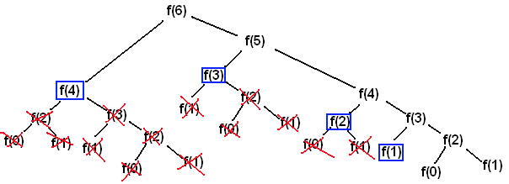
Memoization (A top-down approach)
Memoization is the top-down approach to solving a problem using dynamic programming
It is called “top-down” since we start from some max state, say n, and try to see if we can get to some base state, say 0
It is called memorization because we are making a “memo” for the values returned from solving each problem
When we encounter the same problem again, we can simply check to see if the memo has the answer to the problem. If it does, we retrieve the solution and skip the repeated computation

Slide 8
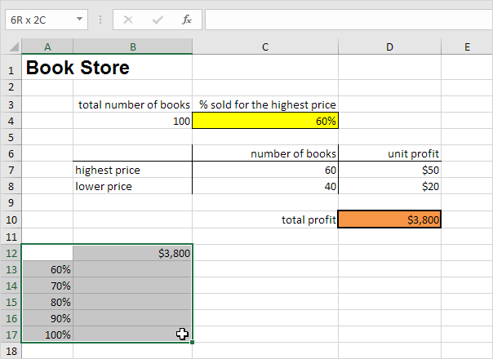
Tabulation (a bottom-up approach)
Tabulation is the bottom-up approach to solving a problem using dynamic programming
It is called a “bottom-up” approach as we start from some base state, say 0, and see if we can make our way to our destination state, say n, to solve a problem at hand
The name “tabulation” comes from the fact that as we iterate from state 0 to state d, we sequentially store the results returned from the previous states
Let’s take one more look at our Fibonacci example and see if we can apply a solution using tabulation
Like with memoization, we can simply use previously returned values that we access from the table if we need them in future calculations

Slide 9
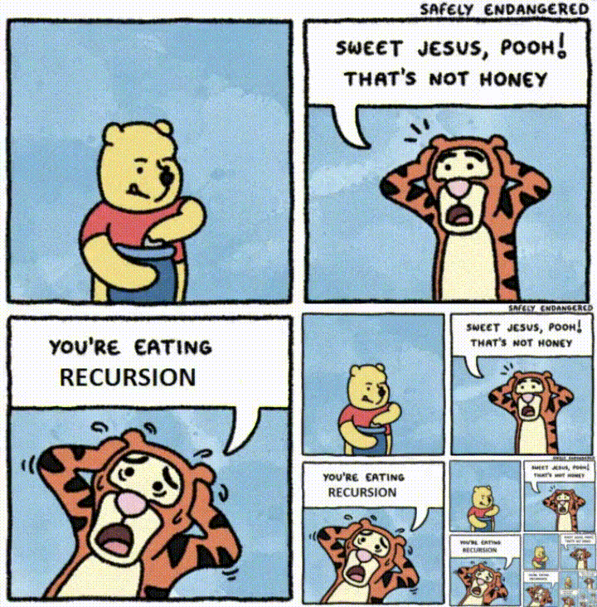
Conclusion and questions
Dynamic programming is an invaluable tool when devising algorithms ranging from simple to complex
It has helped many people create efficient solutions to what were before impossible problems, and will almost certainly continue to do so in the future
If you would like to practice dynamic programming for yourself, I recommend looking at the resources
If you have any questions pertaining to dynamic programming, please feel free to ask
Thank you for listening!!!
https://www.geeksforgeeks.org/dynamic-programming/
https://medium.com/techie-delight/top-10-dynamic-programming-problems-5da486eeb360
https://www.youtube.com/watch?v=oBt53YbR9Kk

